Slide 1
Global Marketing
Management
A European Perspective
Assessing
Global Marketing Opportunities
Warren J. Keegan
Bodo B. Schlegelmilch

Slide 2
Marketing Research
... links the consumer, customer, and public to the marketer through information
Information is used to ...
  identify and define marketing opportunities and problems;
  generate, refine, and evaluate marketing actions;
  monitor marketing performance; and
  improve our understanding of marketing as a process.

Slide 3
Inadequate International Marketing Research Can Cause Costly Mistakes
Examples:
US ketchup -> Japan
US Kentucky Fried Chicken -> Brasil
US Soft Drink -> Indonesia
D Knorr soup -> USA
US cake Mix -> GB
Thus: In international marketing, information is critical in developing effective marketing strategies!

Slide 4
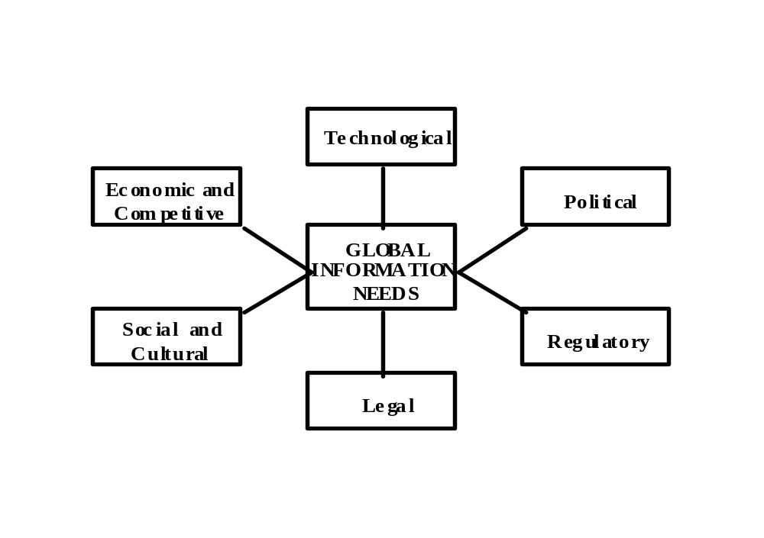
Relevant Dimensions of the
Marketing Environment

Slide 5
Dimensions to be Examined in the Marketing Environment (1)
Economic and competitive environment
  eg GNP, income level, balance-of payment
Technological environment
  eg engineering skills (for production in a specific country)
Political environment
  eg government actions with respect to taxes, equity control, and expropriation

Slide 6
Dimensions to be Examined in the Marketing Environment (2)
Regulatory environment
  eg governmental and non-governmental agencies which enforce laws and set guidelines for conducting business (such as EU or WTO)
Legal environment
  eg patents, trademarks, licensing jurisdiction and antitrust laws
Social and cultural environments
  eg conscious an unconscious values, ideas, attitudes, and symbols

Slide 7
Idiosyncrasies of
Global Marketing Research
Complexity of factors to be considered
  additional markets add complexity
Competition
  more firms have to be taken into account
Lack of research infrastructure
  ... especially in developing countries

Slide 8
Data Compatibility and Equivalence in Global Marketing Research
National markets have unique characteristics
But: It is essential that data have the same meaning and the same level of accuracy, precision of measurement, and reliability
This aspect covers all stages of marketing research from problem definition to data analysis

Slide 9
Secondary Data
Data from sources that already exist - they have not been gathered for the specific research project
Therefore: Minimal effort and cost
Possible problems
  accuracy
  availability
  timeliness
  costs and
  comparability of data

Slide 10
Examples of
Secondary Data Sources
Governments
  Department of Trade and Industry
International Organisations
  UN, OECD, Worldbank,
Trade Associations
  Tradefair International, Japan Export Trade Organisation (JETRO)
Electronic Data Bases
  Euromonitor

Slide 11
Primary Research
... when secondary data are inadequate
... provides accurate data which give exact answers to a given research problem
Possible problems
  difficulties in gaining the data
  cost
  more time is necessary to gather the data

Slide 12
Primary Research Process
Step I: Identifying the research problem
Step 2: Developing a research plan
Step 3: Collecting data
Step 4: Analysing research data
Step 5: Presenting the findings

Slide 13
Organising the
Global Marketing Research Process
Means:
Deciding on research responsibilities
Designing global marketing information systems
Possible scanning modes: surveillance and search
  Surveillance: informal gathering of information, eg about potential opportunities
  Search: more formal activity - seeking of specific information; marketing research is one „method“

Slide 14
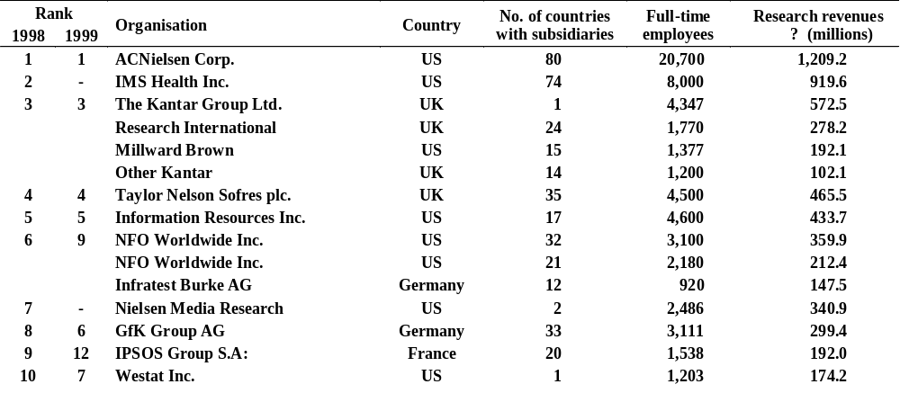
Honomichl Global 25:
The Largest Research Organisations
Source: ”Honomichl Global 25”, Marketing News, 16 August 1999, p.H1

Slide 15
Global
Marketing Information System
A means for gathering, analysing, and reporting relevant data to provide managers and other decision makers with a continuous flow of information about markets, customers, competitors, and company operations.

Slide 16
Summary
Information is one of the most important assets in international marketing
Among the idiosyncrasies of global marketing research are the complexity of factors to be considered and the lack of research infrastructure
Comparability and equivalence in an international context is essential; i.e. the data must have the same meaning and the same level of accuracy, precision of measurement and reliability

